Slide 1

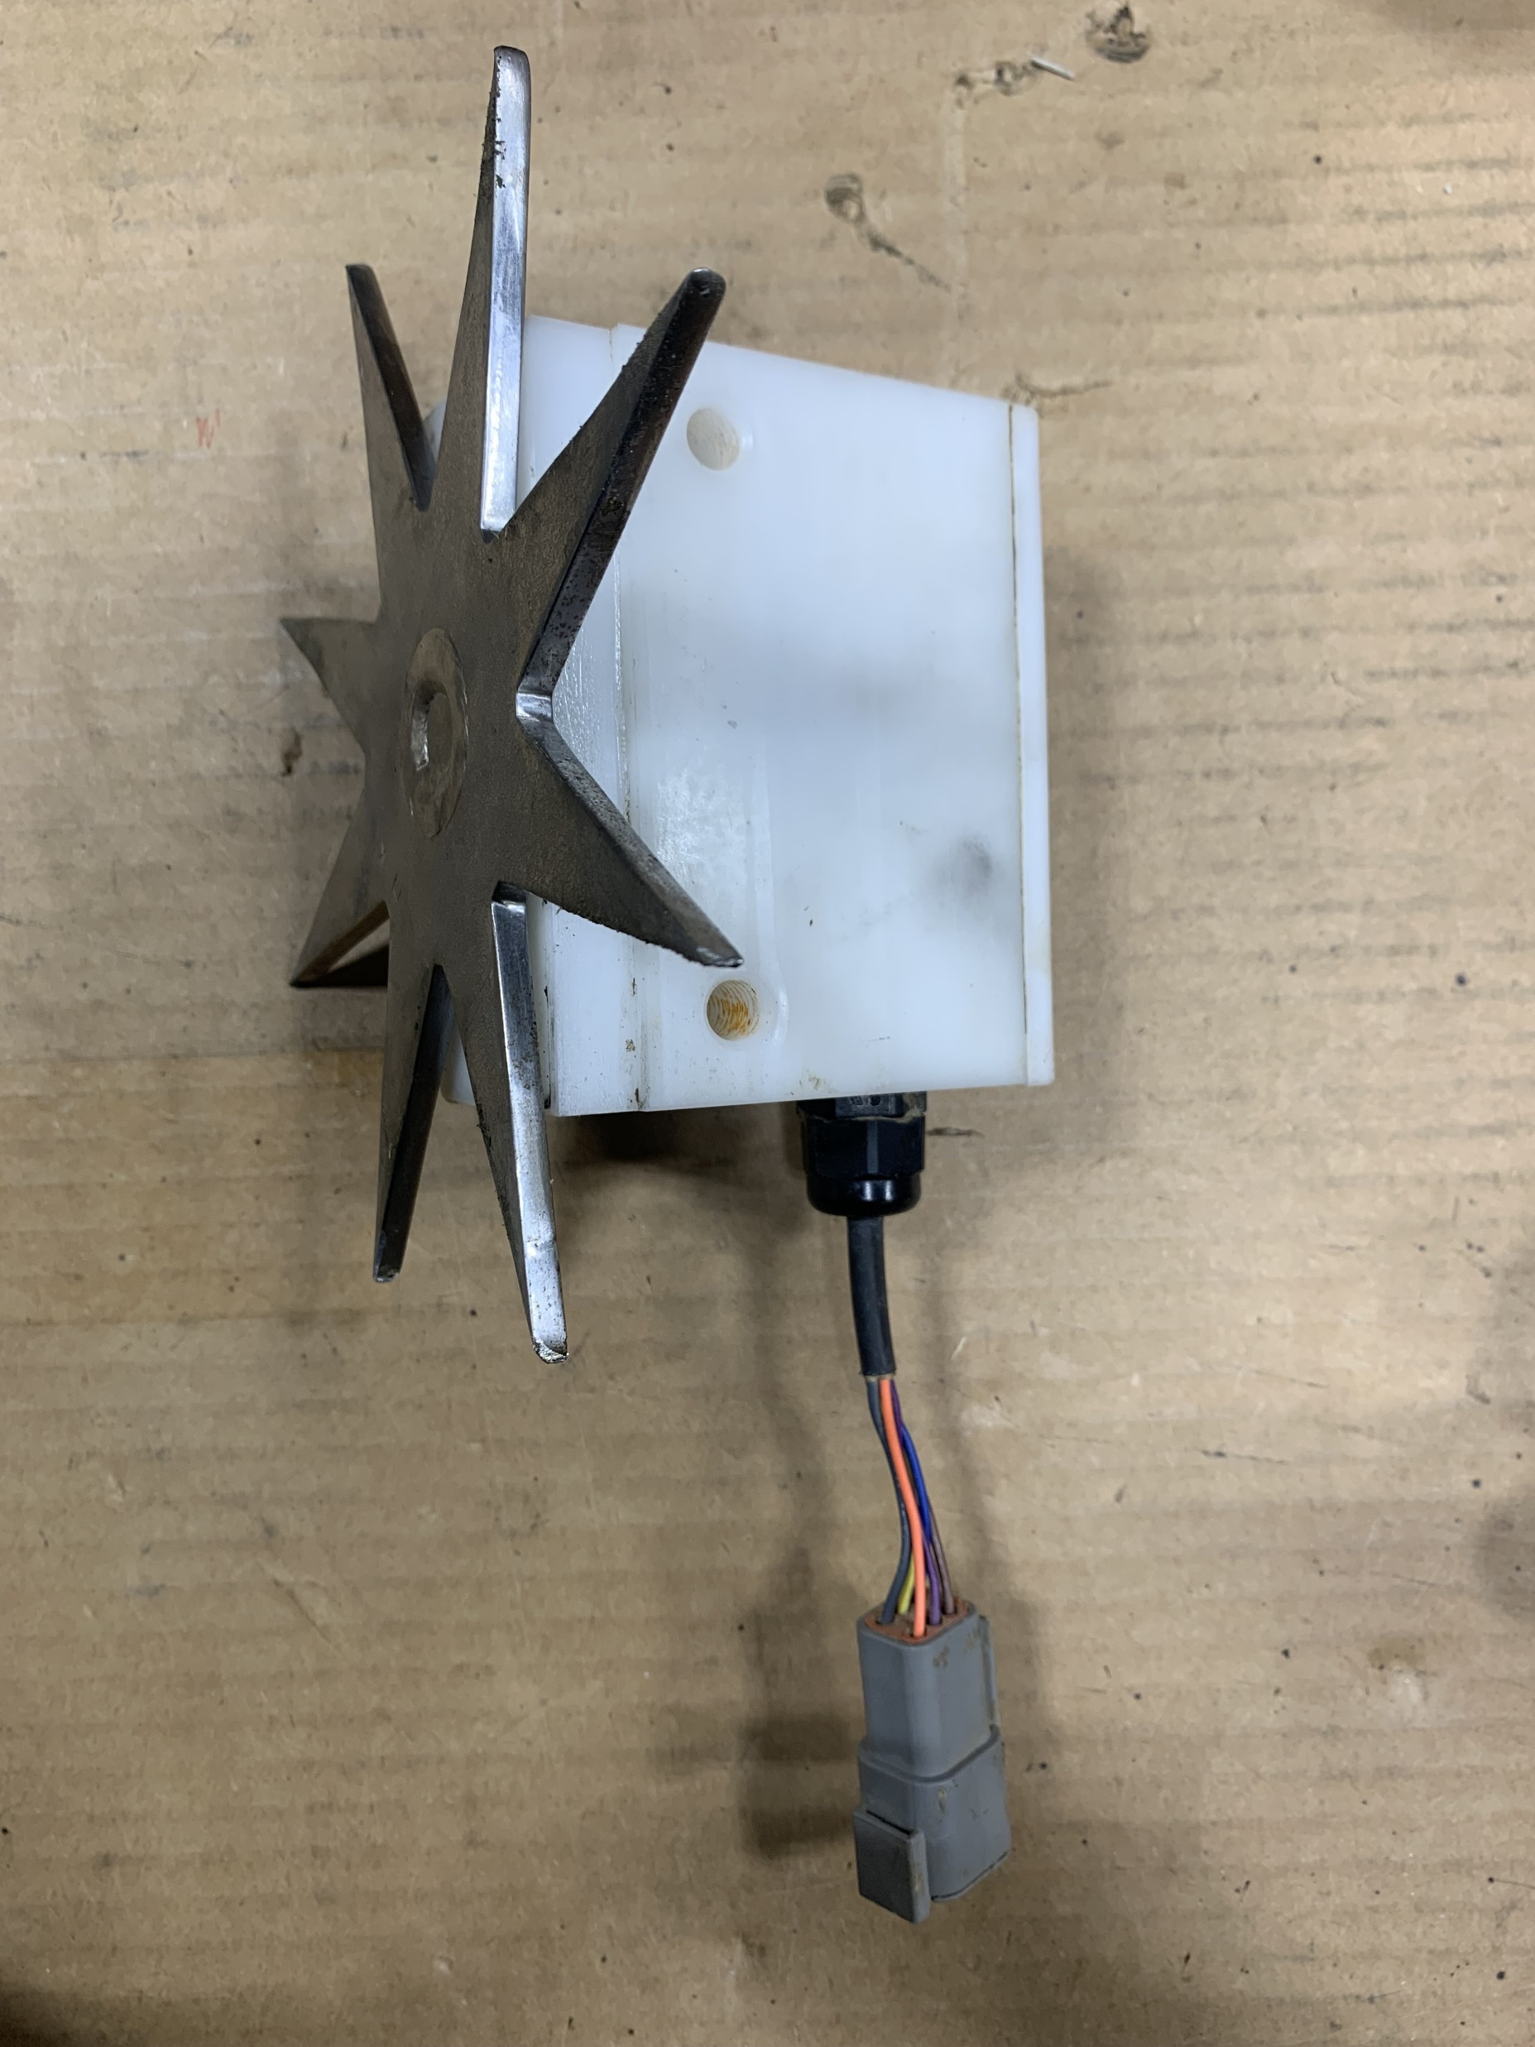
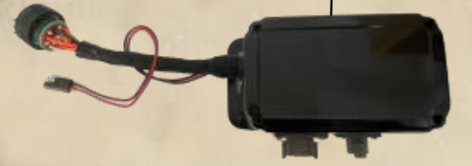
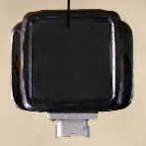
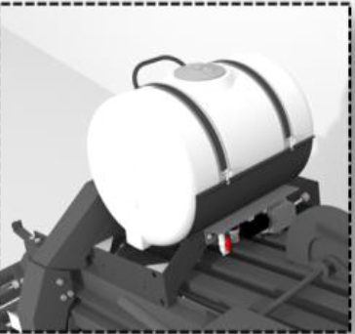
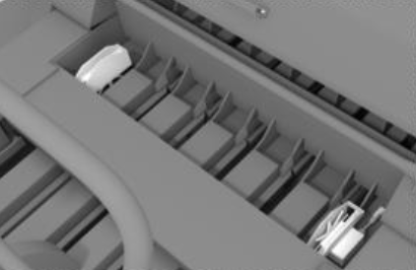
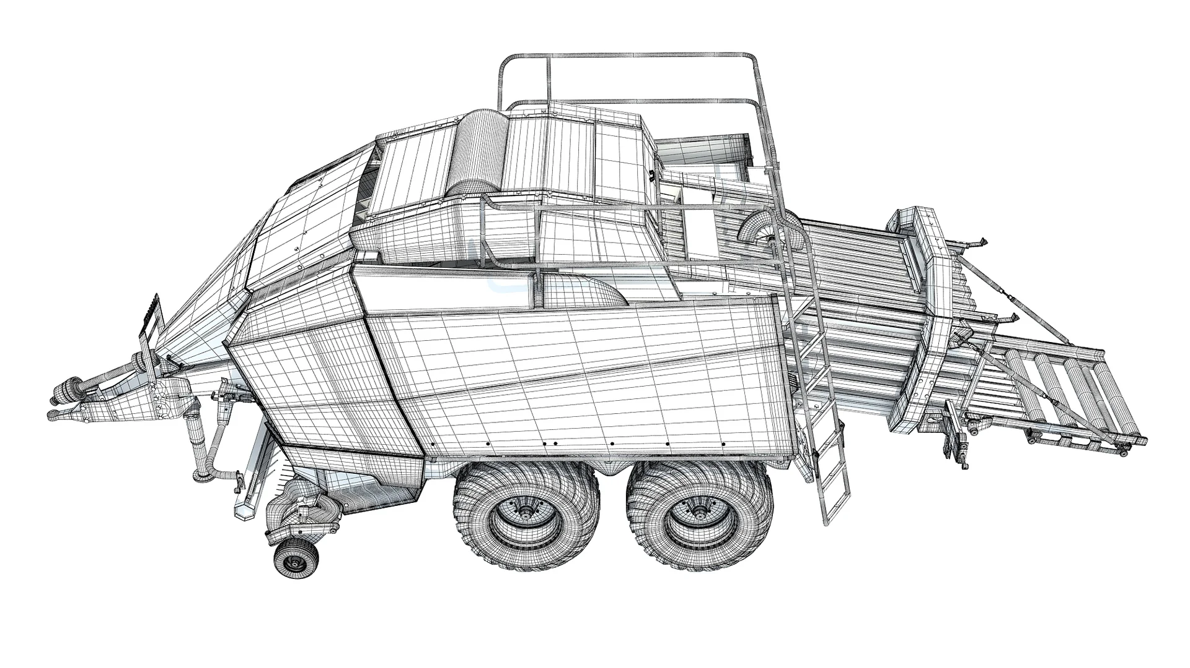
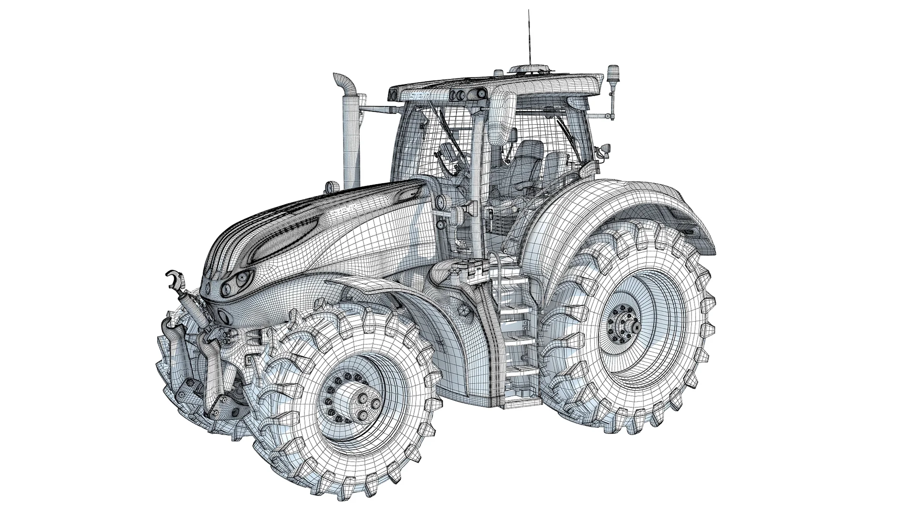
700 Series: Large Square (2021-Current)
Star Wheels
IPM
ICM
*HD BALERS NOTE: Star Wheels on side of chamber

Slide 2
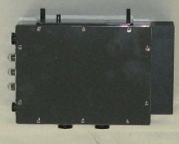
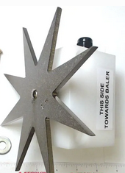
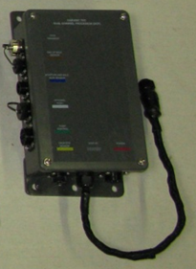

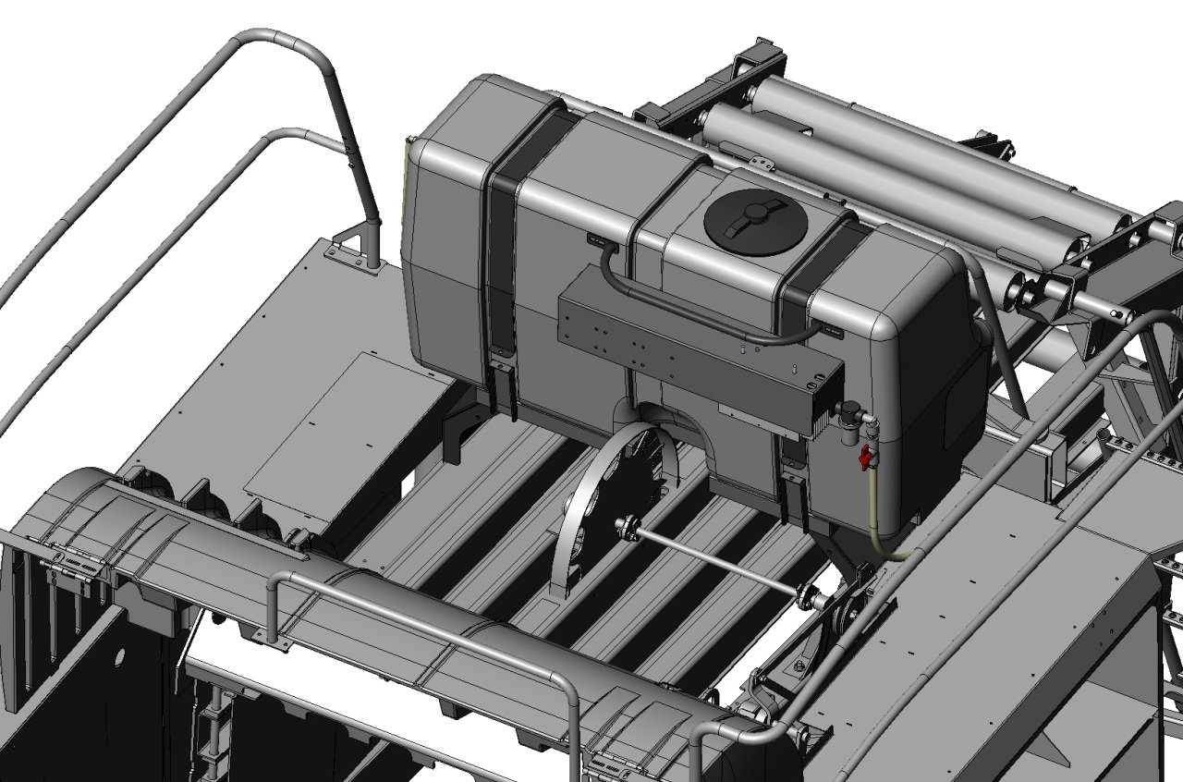

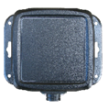
600 Series: Large Square (2013-2020)
Star Wheels
PAC
DCP
TSD
OR
IIC
OR
OR
BLE
*HD BALERS NOTE: Star Wheels on side of chamber

Slide 3
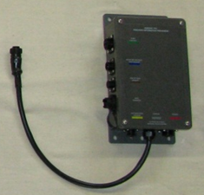
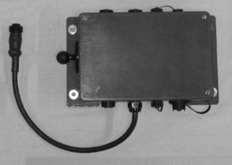
500 Series: Large Square (2008-2012)
PIP
Star Wheels
PIP
OR
TSD
PAC
OR

Slide 4
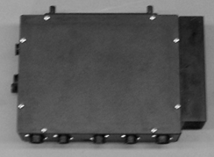
400 Series: Large Square (2005-2007)
BMP
Star Wheels
TSD
OR
BLE

Slide 5
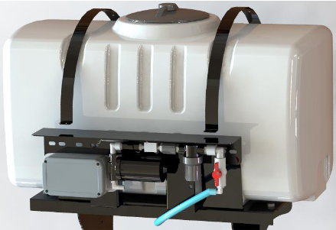
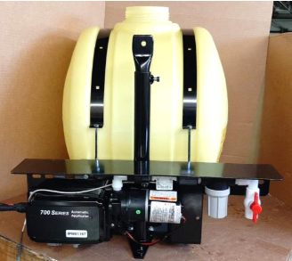
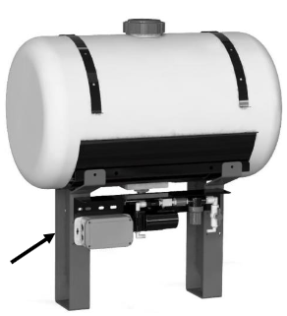
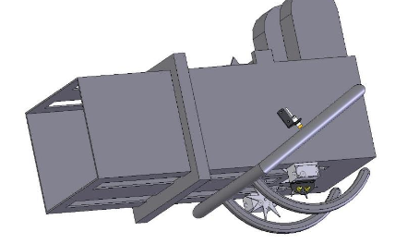
700 Series: Small Square (2024-Current)
Star Wheels
ICM
OR
IPM
OR

Slide 6
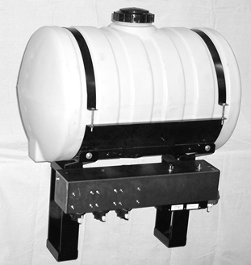
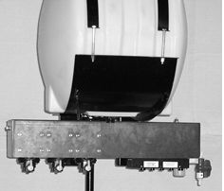
600 Series: Small Square (2013-2023)
DCP
Star Wheels
*Usually mounted on side of baler by twine box
IIC
PAC
TSD
OR
BLE
OR
OR

Slide 7
500 Series: Small Square (2008-2012)
PIP
PIP
OR
Star Wheels
TSD
PAC
*Usually mounted on side of baler by twine box
OR

Slide 8
400 Series: Small Square (2005-2016)
BMP
Star Wheels
TSD
OR
BLE

Slide 9
300 Series: Small Square (2017-Current)
Star Wheels
ICM
OR
THS
OR

Slide 10
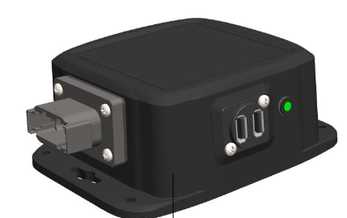
H20: Large Square (2022-Current)
H2O
Star Wheels

Slide 11
H20: Small Square (2022-Current)
H2O
Star Wheels

